Slide 1
Memory Game
Presented by
Dhruv Aggarwal 2210990270
Dhruv Kundrai 2210990276
Gagandeep 2210990312
Under the supervision
Of
Mr. Vikas Patel
Dr. Parul Gehlot
Computer science & engineering
Chitkara University, Punjab

Slide 2
Introduction to Memory game
Memory game, also known as Concentration or Pairs, is a classic game that tests and improves your memory skills. It's a simple yet engaging game that can be enjoyed by people of all ages.
Setup: The game begins with a set of cards laid out face down in a grid pattern on a table or playing surface.
Matching Pairs: Each card in the grid has an identical twin or pair somewhere else in the grid. Players take turns flipping over two cards at a time, trying to find matching pairs.

Slide 3
Introduction to Memory game
3.Memory and Strategy: The challenge of the game lies in remembering the location of previously revealed cards. As players flip over cards and see their faces, they must remember which cards they've seen and where they are located.
4.End of the Game: The game continues with players taking turns flipping over pairs of cards until all pairs have been matched. The player with the most matched pairs at the end of the game is declared the winner.

Slide 4
Motivation behind this game
Educational Purpose : Memory games can be utilized as educational tools to teach concepts, vocabulary, or historical facts.
Cognitive Development: Memory games are
known to enhance cognitive skills such as memory, concentration, and pattern recognition.

Slide 5
Motivation behind the work
3.Entertainment and Recreation: Memory games are enjoyable and can provide entertainment for people of all ages. The motivation behind the project could simply be to create a fun and engaging game for leisure purposes, whether as a standalone project or as part of a larger game collection.
4.Research and Experimentation: Developing a memory game project could be motivated by a desire to explore game design principles, user interaction patterns, or technological advancements.

Slide 6

Tools and Technologies
HTML (Hyper Text Markup Language):
It provides the structure and content of a
webpage by using various elements and tags.
HTML elements represent different parts of a webpage, such as headings, paragraphs, images, links, forms, and more.

Slide 7


Tools and technologies
CSS (Cascading Style Sheets):
CSS is a style sheet language used for describing the
presentation and formatting of HTML elements on a webpage.
It allows web developers to control the appearance of various elements, such as colors, fonts, spacing, layout, and positioning.
JS (JavaScript):
JavaScript is a high-level, interpreted programming language that adds interactivity and dynamic behavior to web pages.
It is commonly used for client-side scripting, meaning it runs in the web browser of the user.

Slide 8
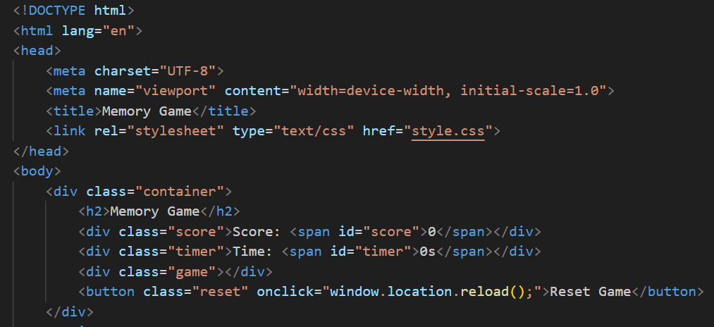
Html code

Slide 9
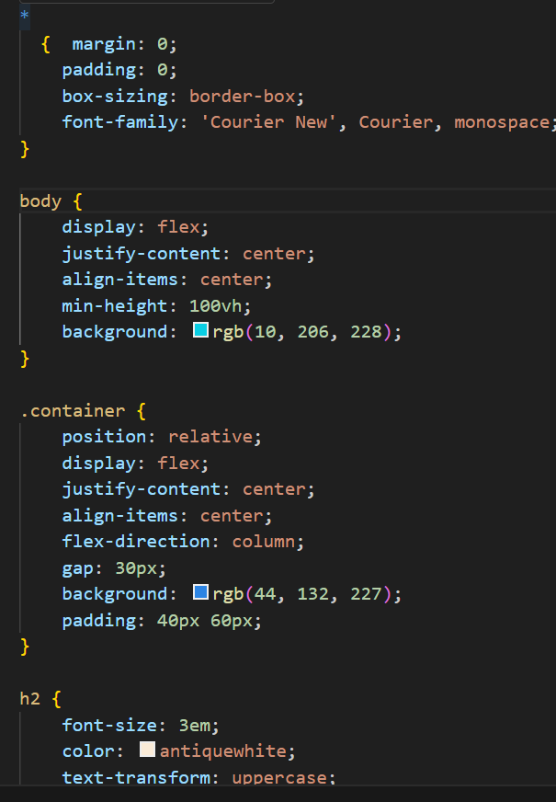
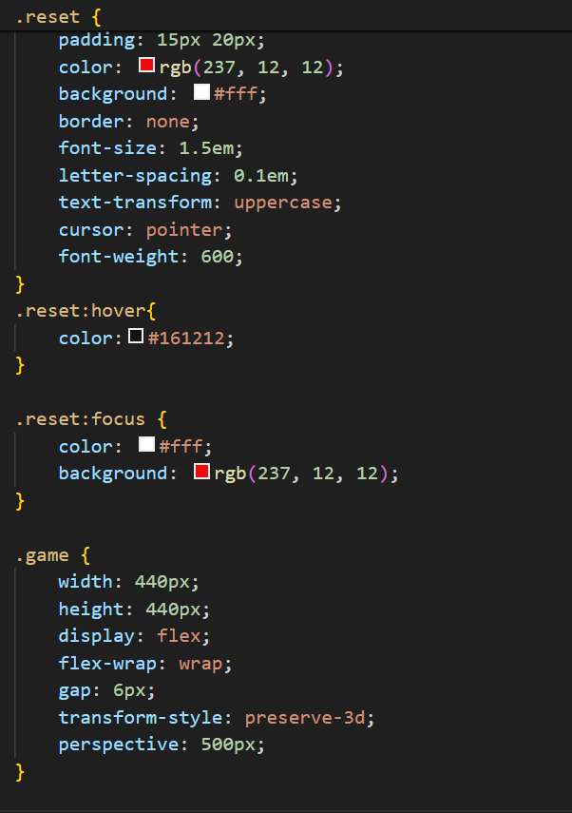
CSS code

Slide 10
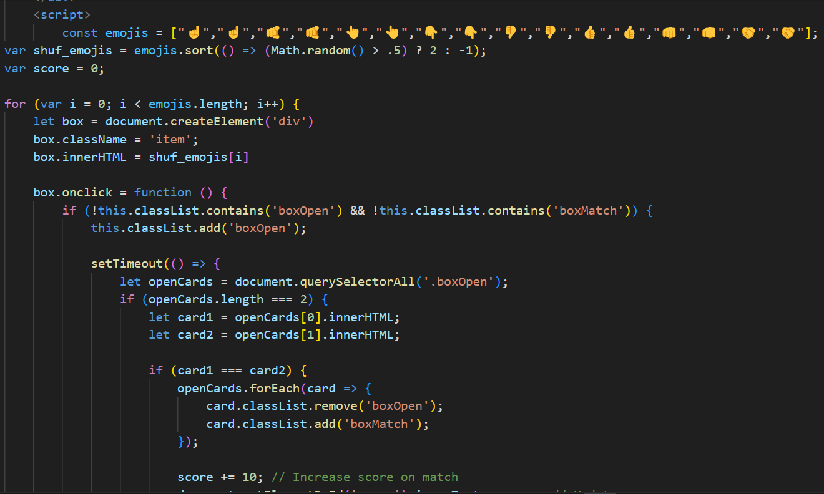
JS code

Slide 11
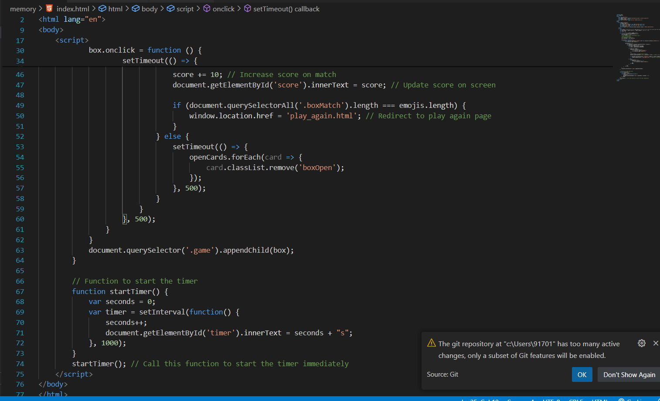
JS Code

Slide 12
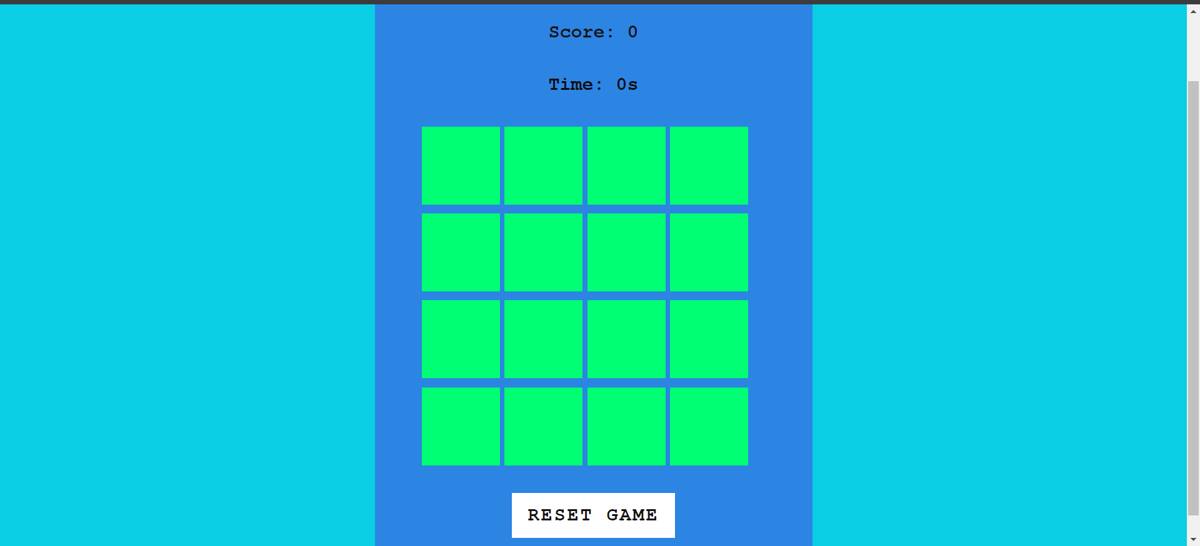
Final output

Slide 13
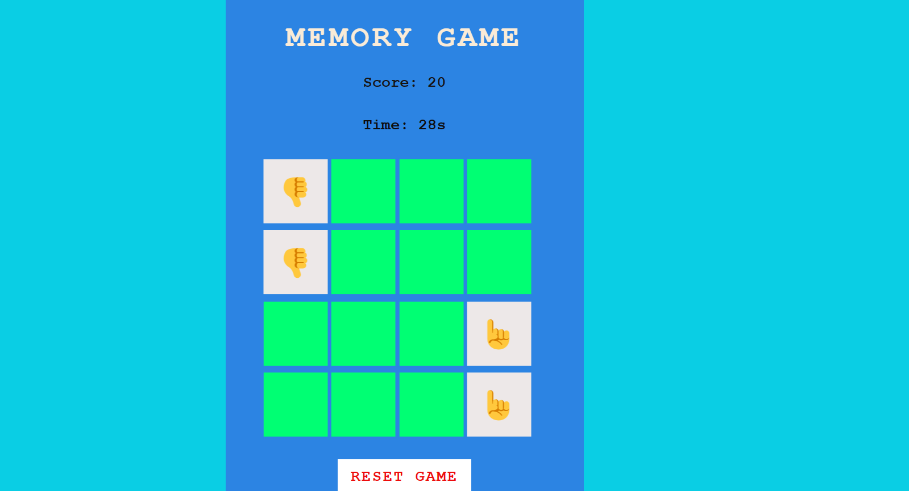
Final output

Slide 14
References
W3 school-https://www.w3schools.com/jsref/met_win_settimeout.asp,
Youtube - https://www.youtube.com/watch?v=ajdRvxDWH4w&list=PLGjplNEQ1it_oTvuLRNqXfz_v_0pq6unW&ab_channel=ShradhaKhapra

Slide 15


